Slide 1


CAPSTONE PROJECT
Global Superstore Sales & Profit Analysis Dashboard
Presented By
Student Name: SHIVANI
College Name: MAKHANLAL CHATURVEDI NATIONAL UNIVERSITY OF JOURNALISM AND COMMUNICATION
Department: COMPUTER APPLICATION
Email ID: iamshivani8707@gmail.com

Slide 2
OUTLINE:
Problem Statement
Proposed System/Solution
System Development Approach
Algorithm & Deployment
Result (Output Image)
Conclusion
Future Scope
References

Slide 3
Problem Statement:
Retail Companies generate large amounts of sales data from different regions, categories, and customer segments. However, analysing this data manually is difficult and time consuming. Businesses needed an effective way to track sales performance, identify profitable products, and understand regional trends.
Without proper data visualization, it becomes challenging for decision-makers to identify patterns and make strategic business decisions.

Slide 4
Proposed Solution:
The proposed solution is to develop an interactive business intelligence dashboard using Microsoft Power BI.
The dashboard will analyze retail sales data and provide insights such as:
• Total Sales and Profit • Sales performance by category and region • Product profitability analysis • Discount impact on profit
This system will allow decision-makers to quickly explore business data and identify opportunities for improving sales and profitability.

Slide 5
System Approach:
Tools and Technologies Used:
• Data Visualization Tool: Microsoft Power BI • Data Source: Retail Sales Dataset • Data Processing: Power Query Editor • Data Modelling: DAX (Data Analysis Expressions) • Visualization Techniques: Charts, KPI Cards, Slicers, and Interactive Dashboards
Steps followed in the development:
Data Collection
Data Cleaning and Transformation
Data Modelling
Dashboard Development
Data Visualization and Insights Generation

Slide 6
Algorithm & Deployment:
Algorithm Selection
The project applies data analysis and visualization in Microsoft Power BI rather than complex machine learning. DAX functions were used to calculate key KPIs like sales, profit, margin, orders, and quantity sold.
Data Input
Inputs included transactional sales data, product details, and order records.
Training Process
Data was cleaned and transformed with Power Query to ensure accuracy and consistency before analysis.
Prediction/Analysis Process
A Power BI Desktop dashboard was deployed, enabling users to interact with filters and visualizations to explore business insights.

Slide 7
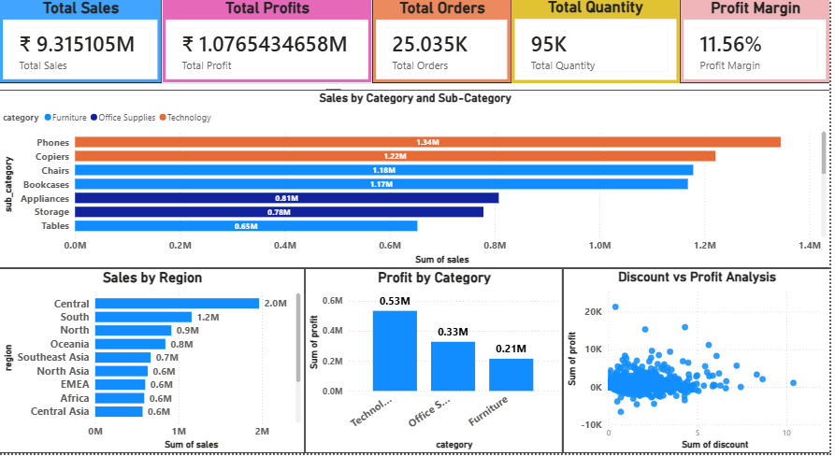
Result:
The developed dashboard successfully visualizes retail business performance. It allows users to explore sales trends, profitability, and product performance through interactive charts and filters.
Key insights obtained include:
• Identification of top-selling product categories • Regional sales performance comparison • Analysis of profit margins across categories • Impact of discounts on profitability

Slide 8
Conclusion:
This project demonstrates the effective use of business intelligence tools to analyze retail sales data.
The dashboard provides meaningful insights into sales performance, product profitability, and regional trends. By transforming raw data into visual reports, businesses can make informed decisions that improve operational efficiency and profitability.
The project highlights the importance of data-driven decision making in modern businesses.

Slide 9
Future scope:
Future improvements for this project may include:
• Integration with real-time sales databases • Implementation of machine learning models for sales forecasting • Deployment of the dashboard on **Microsoft Power BI Service for online access • Expansion of analysis to include customer behavior and marketing performance
These improvements can further enhance business decision-making capabilities.

Slide 10
References:
• Microsoft Power BI Documentation • Kaggle Retail Sales Dataset • Data Visualization and Business Intelligence Resources • Online tutorials and documentation related to Microsoft Power BI
GitHub Link:

Slide 11
Thank You

